Slide 1
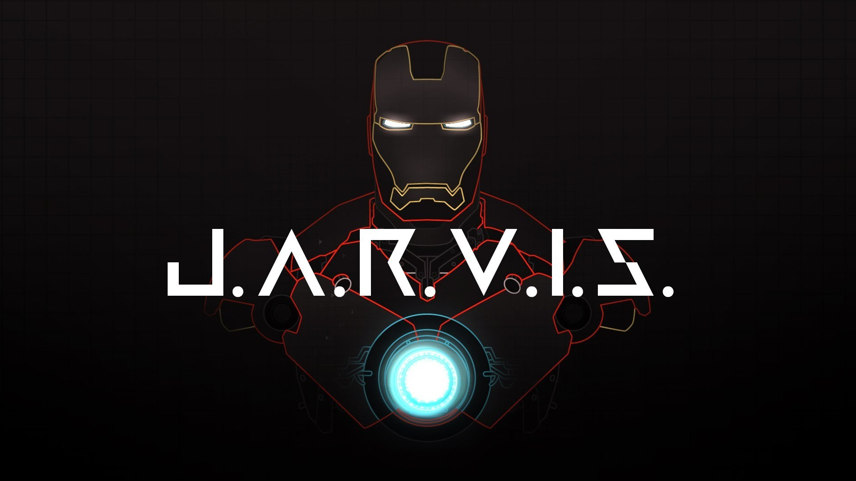
AI VOICE CHAT BOT
Presented by
A Siddesh

Slide 2

ABOUT JARVIS:-
JARVIS, Which Stands For “Just A Rather Very Intelligent System,” Is A Fictional Artificial Intelligence System From The Marvel Cinematic Universe, Primarily Featured In The Iron Man And Avengers Films. Created By Tony Stark (Iron Man), JARVIS Helps Manage Stark’s Technology And Provides Assistance In Various Tasks, From Operating The Iron Man Suit To Managing His Day-to-day Activities.
JARVIS is characterized by his advanced AI capabilities, conversational abilities, and a touch of British charm, voiced by actor Paul Bettany. In the MCU, JARVIS eventually evolves into the character Vision, thanks to the Mind Stone and other components.
Our goal is to create A similar voice chat bot using python.

Slide 3

Tools and Technologies
Content:
Python: Primary programming language.
Speech Recognition: For converting speech to text.
pyttsx3: Text-to-speech conversion library.
NLTK (Natural Language Toolkit): For natural language processing.
APIs: Various APIs for extended functionalities (e.g., weather, news)

Slide 4

Setting Up the Environment
Install Python from the official website.
Install required libraries:
Code: “pip install SpeechRecognition pyttsx3 nltk”
Configure NLTK:
Code: import nltk
nltk.download('punkt')

Slide 5
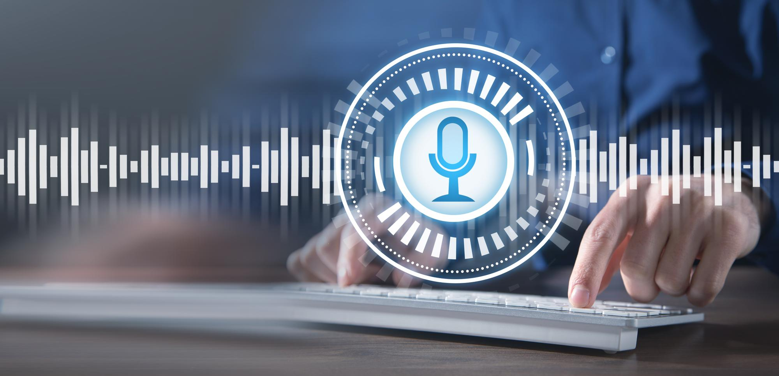
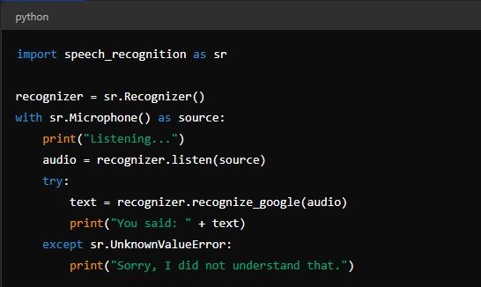
Speech Recognition
Using Speech recognition To Capture Voice Input.
Code snippet:

Slide 6
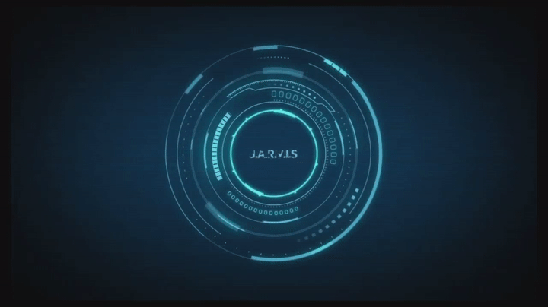
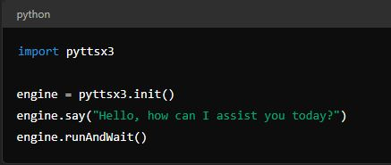
Text-to-Speech Conversion
Using pyttsx3 for converting text to speech.
Code snippet :

Slide 7
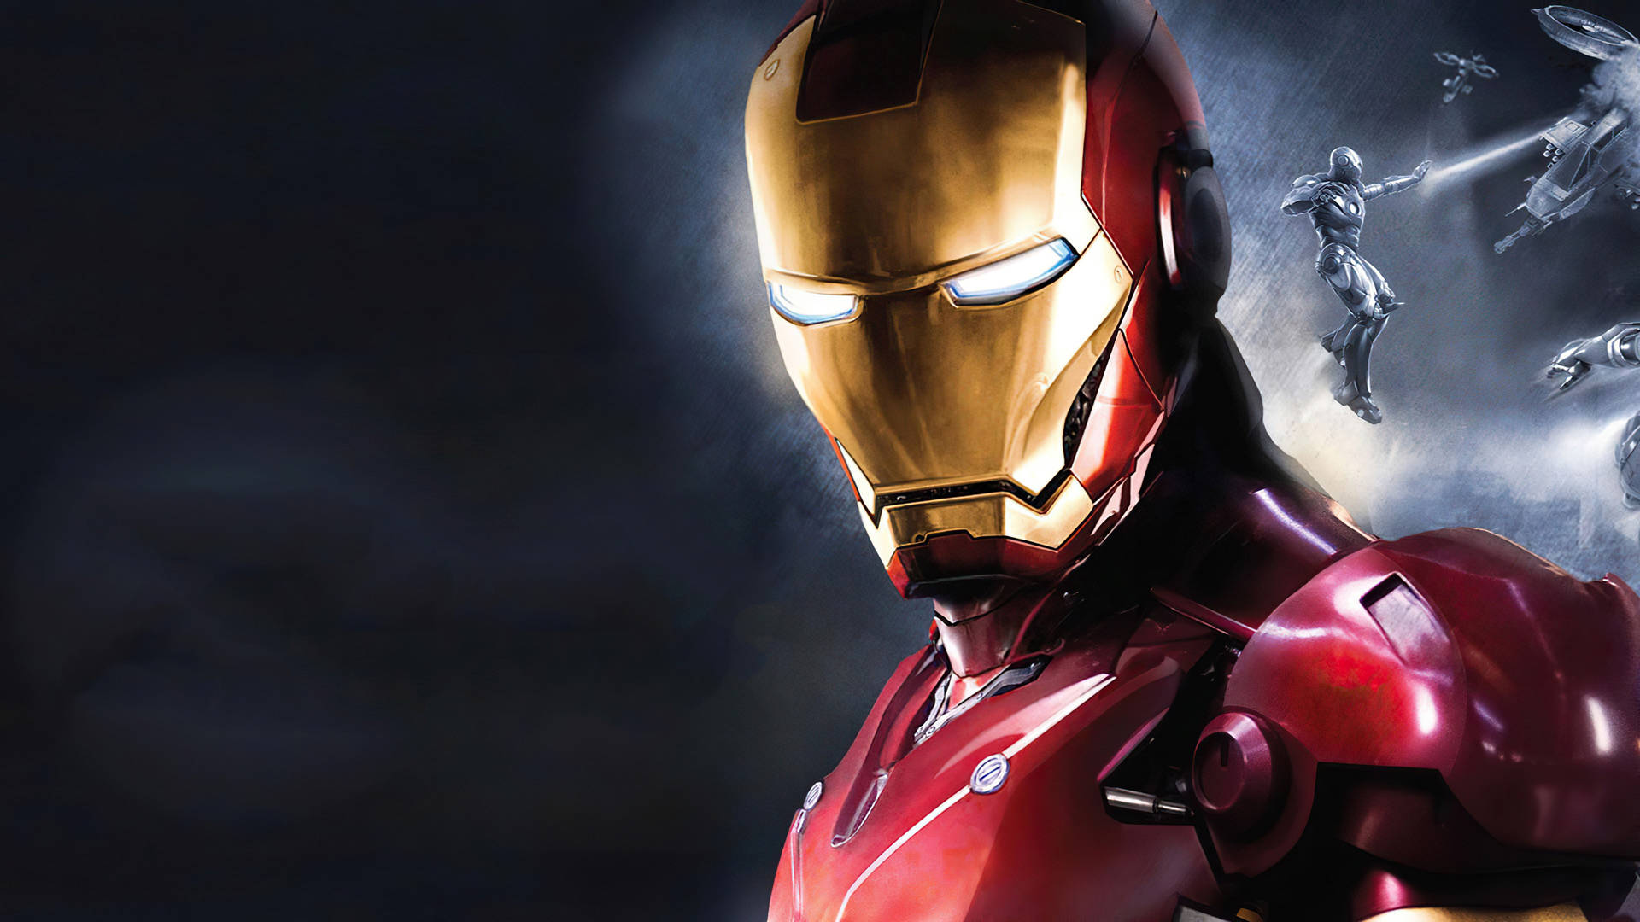
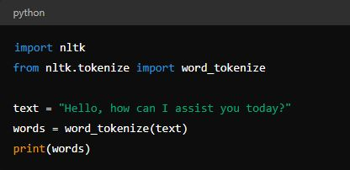
Natural Language Processing
Using NLTK for basic NLP tasks.
Tokenizing sentences and words

Slide 8
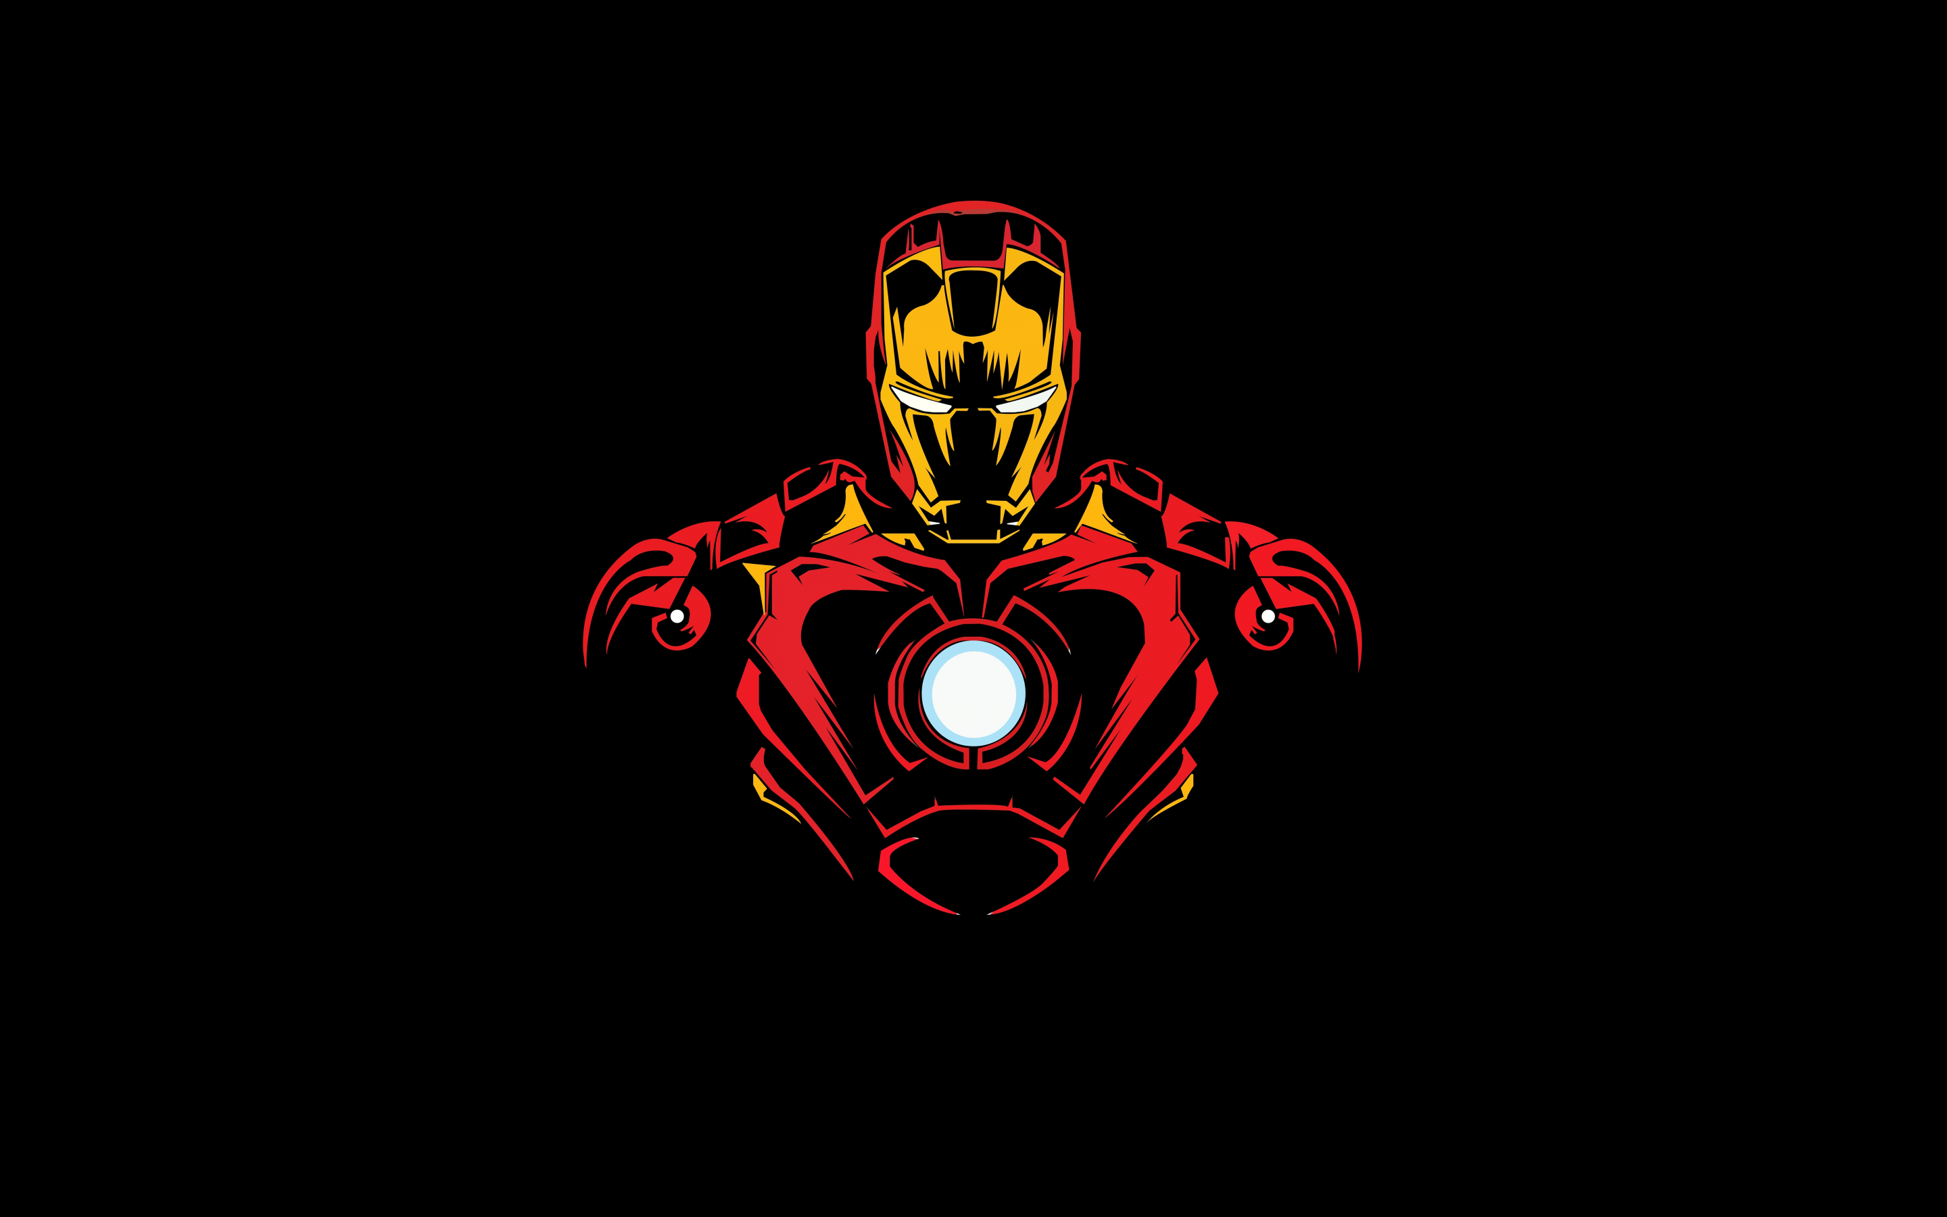
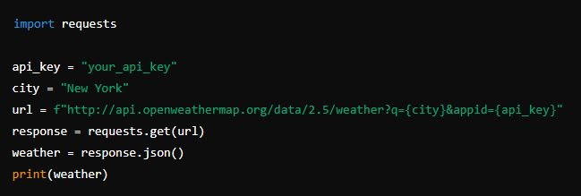
Integrating APIs
Using external APIs for extended functionalities.
Example: Fetching weather information.
Code snippet

Slide 9

Building the Chat Bot
Combine speech recognition, text-to-speech, and NLP.
Pseudocode:
Capture voice input.
Convert speech to text.
Process text for intent.
Fetch information using APIs if needed.
Convert response text to speech.

Slide 10
def main():
recognizer = sr.Recognizer()
engine = pyttsx3.init()
while True:
with sr.Microphone() as source:
print("Listening...")
audio = recognizer.listen(source)
try:
text = recognizer.recognize_google(audio)
print("You said: " + text)
# Process text and generate response
response = process_text(text)
engine.say(response)
engine.runAndWait()
except sr.UnknownValueError:
engine.say("Sorry, I did not understand that.")
engine.runAndWait()
def process_text(text):
# Add NLP and API integration here
return "This is a placeholder response."
if __name__ == "__main__":
main()
def process_text(text):
# Add NLP and API integration here
return "This is a placeholder response."
if __name__ == "__main__":
main()
def process_text(text):
# Add NLP and API integration here
return "This is a placeholder response."
if __name__ == "__main__":
main()
def process_text(text):
# Add NLP and API integration here
return "This is a placeholder response."
if __name__ == "__main__":
main()

Slide 11
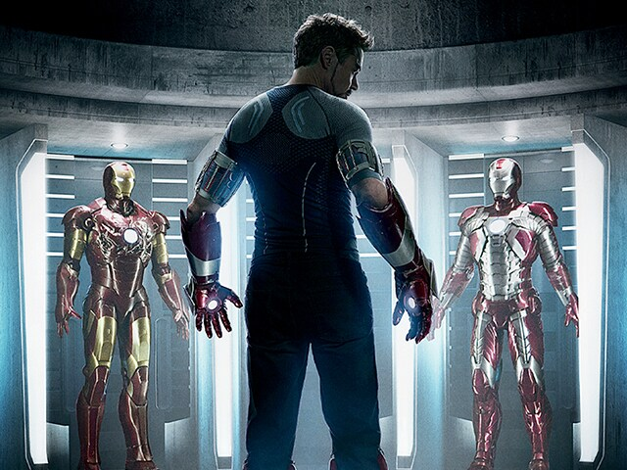
Demonstration
Live demo of the Jarvis AI voice chat bot.
Showcasing voice recognition, text processing, and voice response.

Slide 12
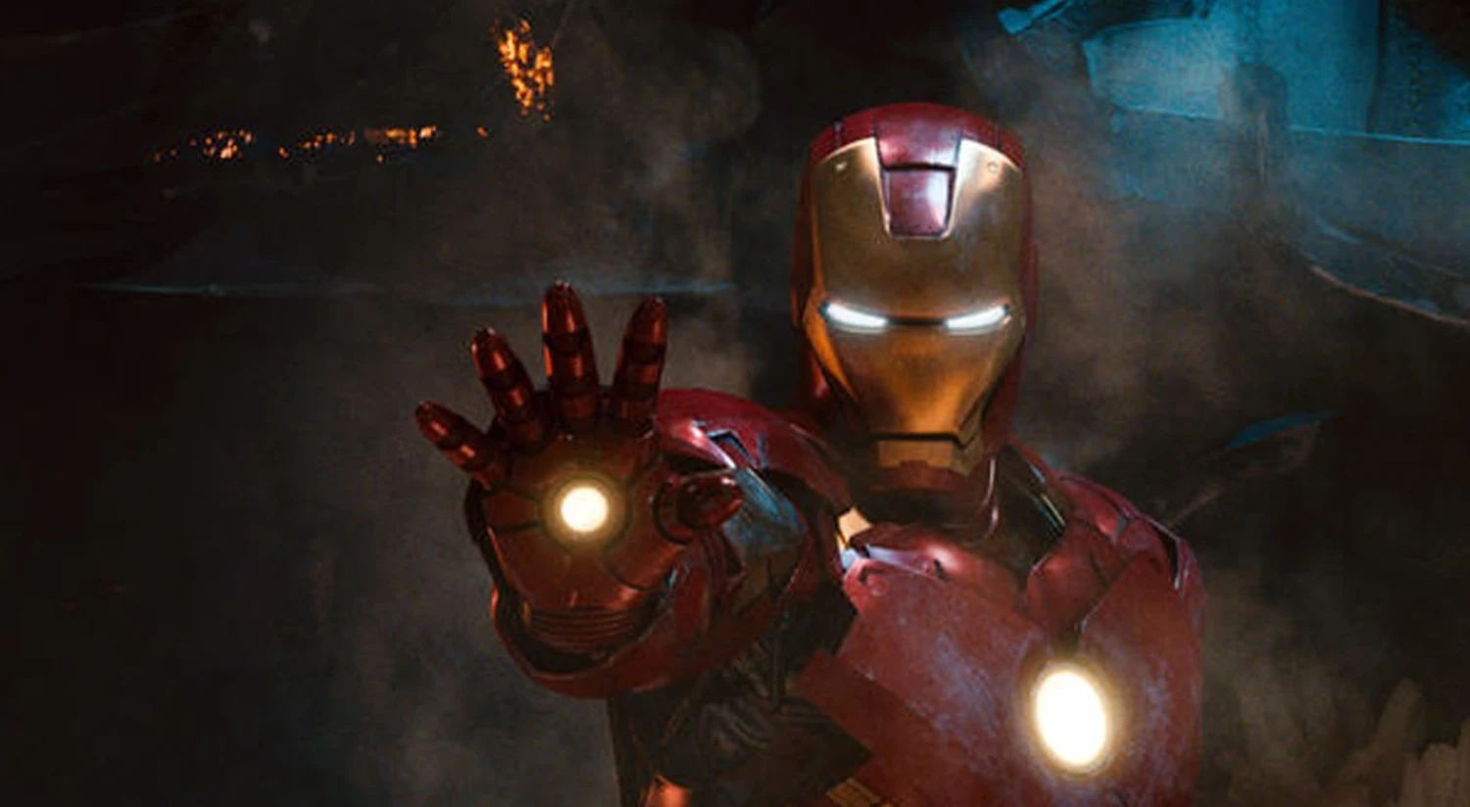
Challenges and Solutions
Speech Recognition Accuracy: Use high-quality microphone, handle noise.
NLP Complexity: Use advanced NLP models (e.g., spaCy, Transformer models).
API Rate Limits: Handle API limits and errors gracefully.

Slide 13

Future Enhancements
Integrate more advanced NLP models (e.g., GPT-3)
Add more functionalities (e.g., home automation, personalized responses)
Improve user interface and experience.

Slide 14
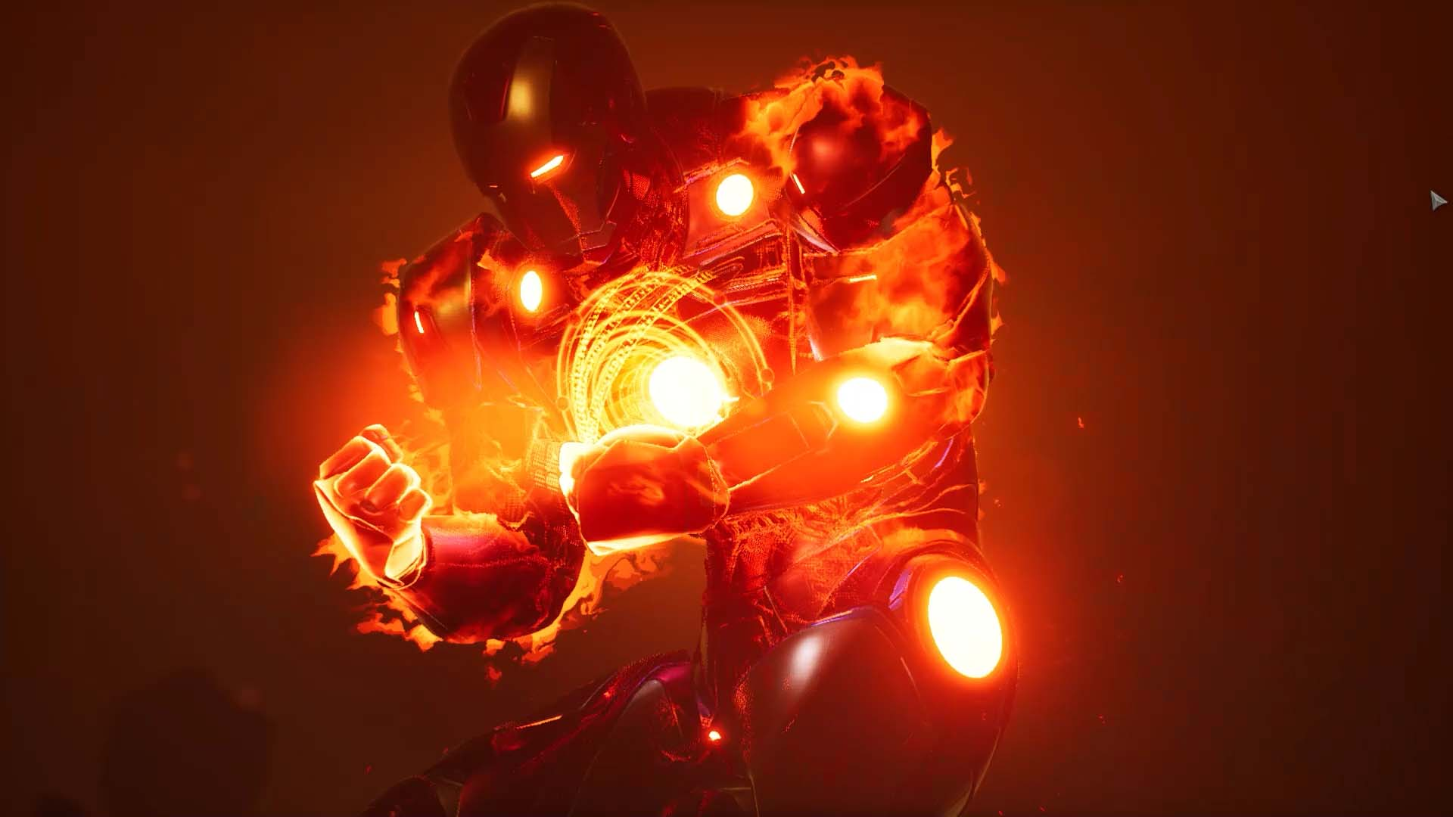
Conclusion
Recap of the Jarvis AI voice chat bot development.
Emphasize the potential and versatility of AI voice assistants.
Thank the audience for their attention.

Slide 15

THANK
you

